Slide 1
24 Oct

Slide 2
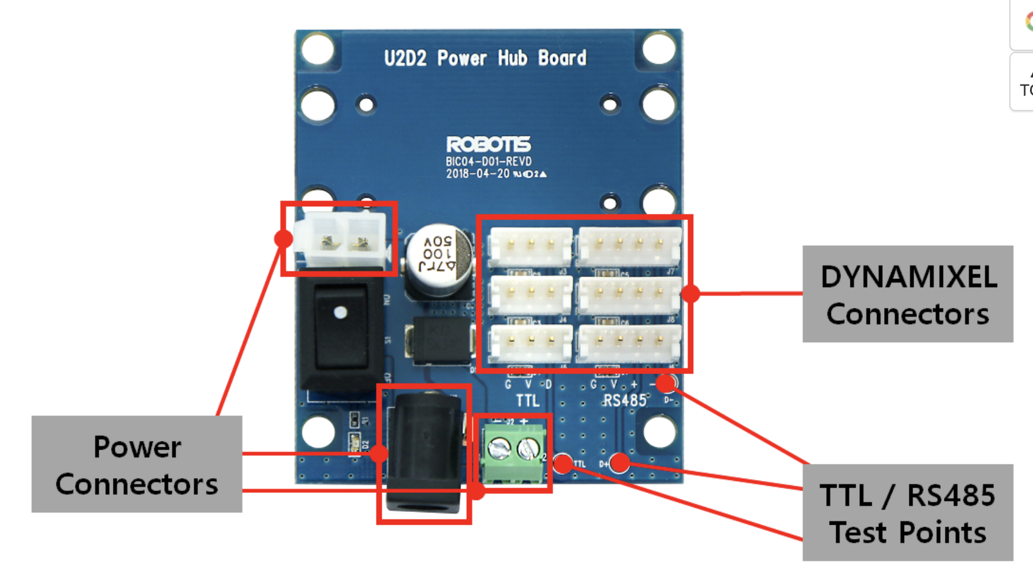
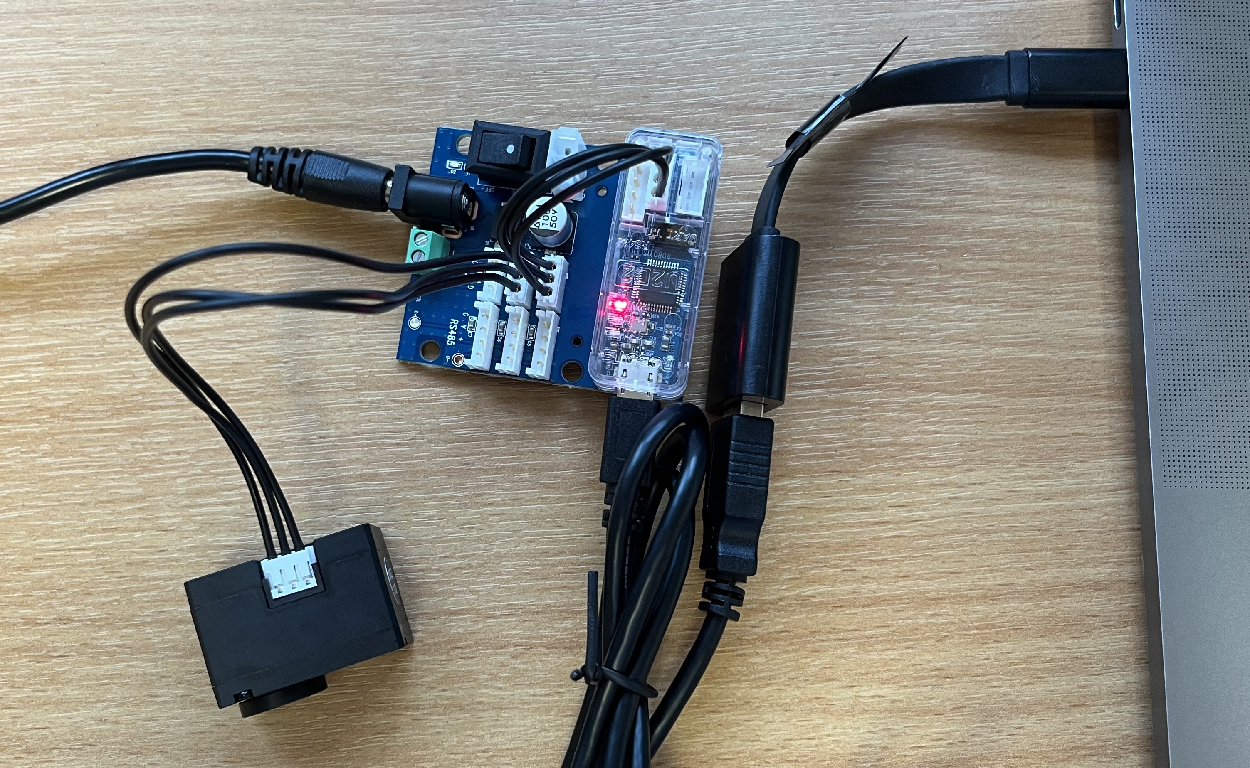
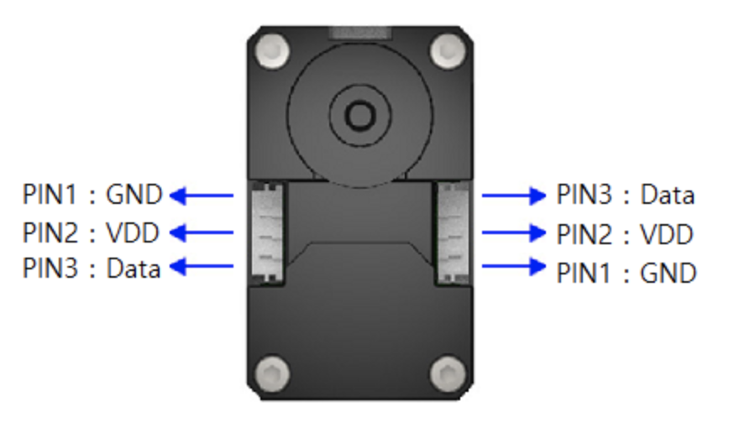
Dynamixel hardware setup
U2D2 PHB set
Operating voltage: 3.5 V ~ 24.0 V
Maximum current: 10.0 A
TTL/RS485-based DYNAMIXEL
U2D2
USB-DYNAMIXEL signal converter Driver available for Windows/Linux
XL330-M288
(Dynamixel Protocol 2.0)
Input: 5.0 V recommended
AC adaptor
Power for DYNAMIXEL
Notes:
The model info:
https://emanual.robotis.com/docs/en/dxl/x/xl330-m288/#control-table
Powerhub info
https://emanual.robotis.com/docs/en/parts/interface/u2d2_power_hub/

Slide 3
Download SDK (library)
Download here
DYNAMIXEL SDK 3.7.31.zip for ROS1, Python, C, C++, C#, MATLAB, LabView, Java
DYNAMIXEL SDK 3.7.30.zip for ROS2
ROS library (C++ library and Python module)
DYNAMIXEL SDK 3.7.31: Because all languages are included, import the language specific dynamixel_sdk (import python/src/dynamixel_sdk directory if using python)

Slide 4
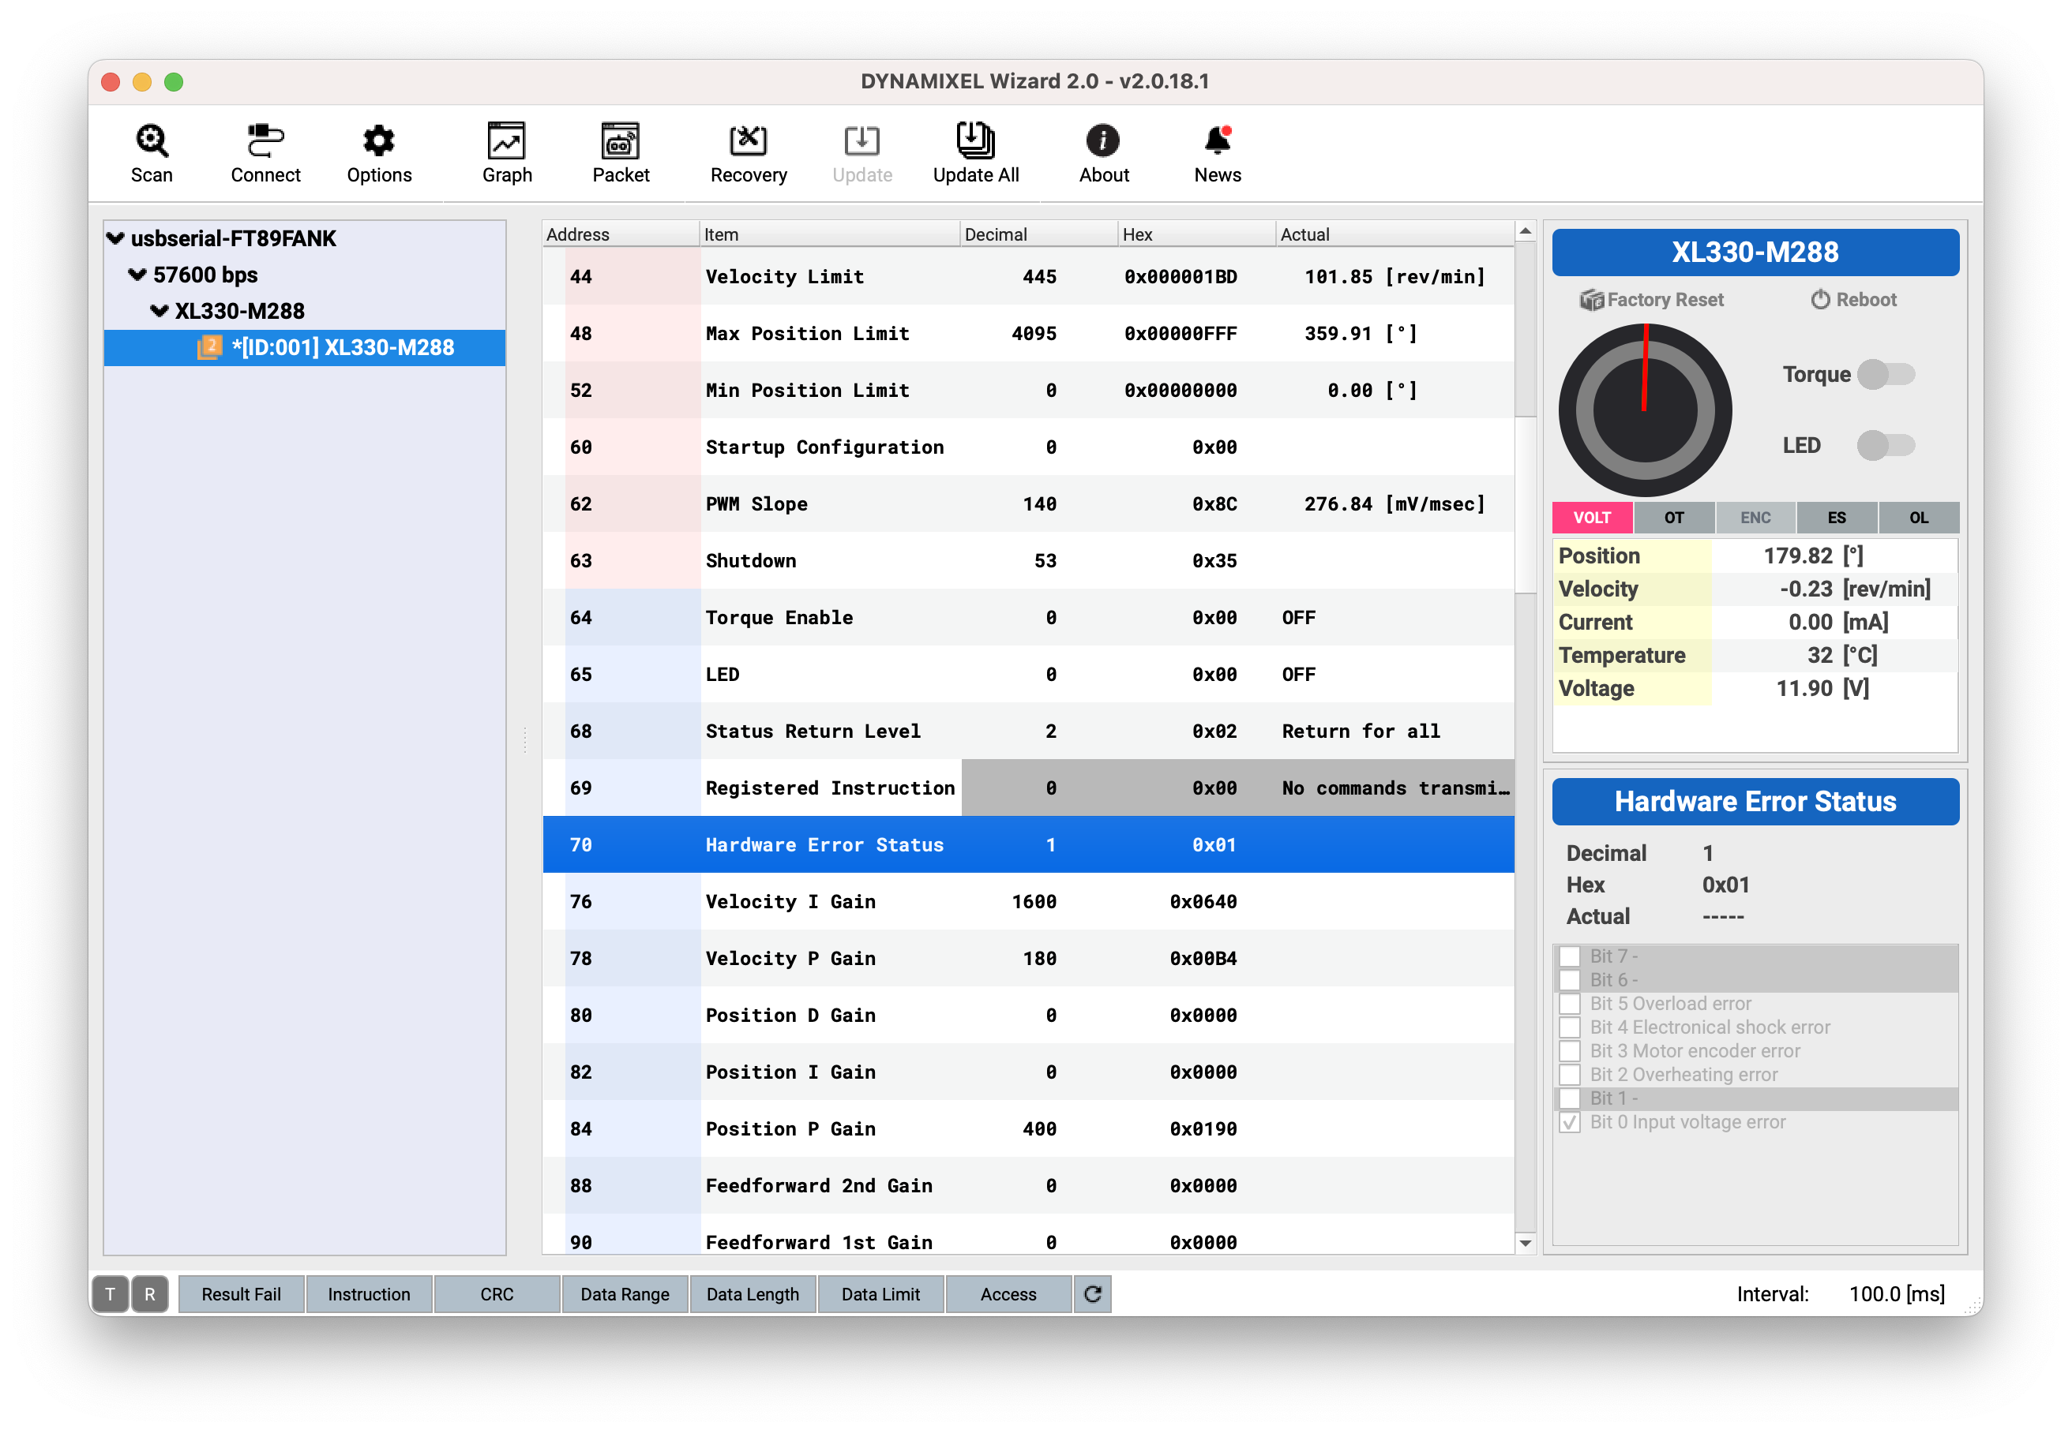
Convinient software: Wizard 2.0
Install here
In options, select scan range.
Click Scan to find connected device.
Read information from “control table”. Check details on dynamixel model page (XL330-M288-T)
Control table

Slide 5
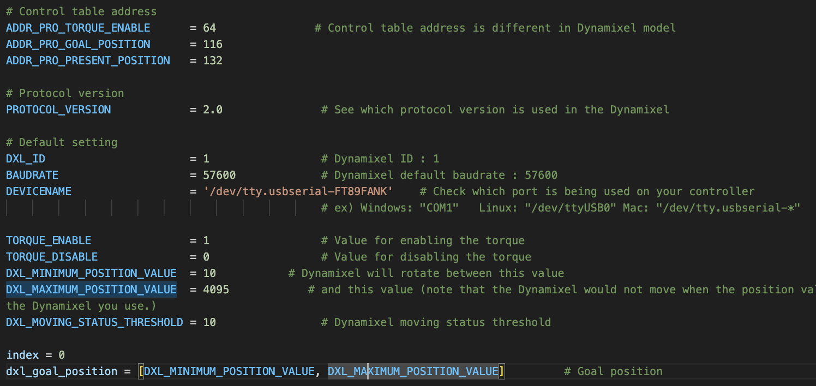

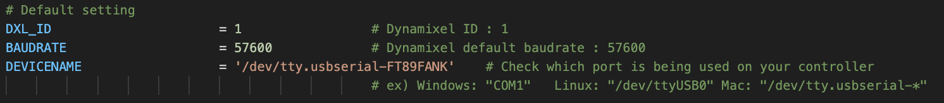
Test the Dynamixel
Test codes available in Dynamixel SDK. (in DynamixelSDK-3.7.31/python/tests/ protocol*)
Check your dynamixel model’s protocol on ROBOTIS e-Manual website.
1. Import dynamixel_sdk from the appropriate source
2. Check all information matches your Dynamixel model. Check which port is used by Dynamixel and change the DEVICENAME.
On mac, use: ls /dev/tty* to check connections. Easiest: plug in and out to see which is the Dynamixel connection.
3. Run the code! Sample code explaination here

